Slide 1
Developed By: Option B
B-Track
Bus Information Tracking Solution
Supervised By: Md. Moniruzzaman, Manager Operation, Joarshahara Bus Depot, BRTC.

Slide 2
B-Track
B-Track is a complete solution for BRTC to track buses details information with different types of accounting report.
Modules Are:
Bus history tracking
Accounting
Reporting
Used Technology:
Angular 4
Web API, C#
SQL Server 2014
Live Link
Option-b.com

Slide 3
Why B-Track
Why B-Track?
Reduce Dependency
On Click Report
Shared Information
Archive Data
Maintain proper channel and auto signature
Next Year Projection
Features
Track every bus details
Daily bus log report
Daily bus position report
Daily income report
Payslip report which are used or not
Monthly individual bus income report route wise
Monthly income report route wise
Monthly Income Report Bus Type Wise

Slide 4
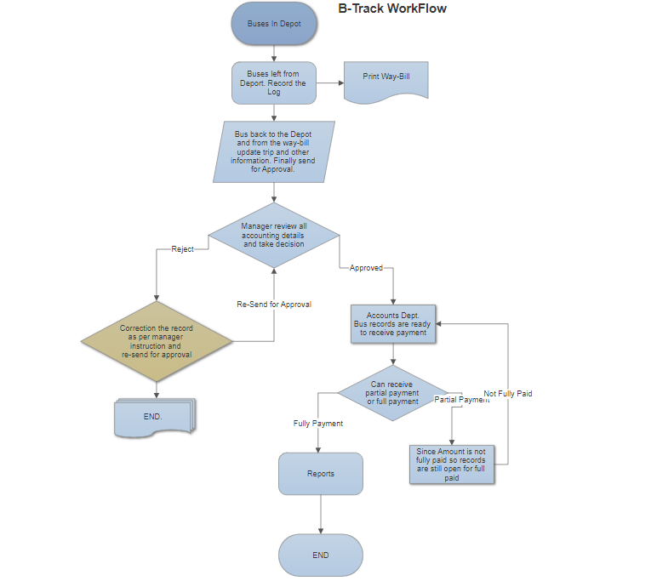
Work Flow

Slide 5
Master Data
Master Information which taken once
Bus Type
Bus List
Driver List
Route List
Route Income
Payslip Book

Slide 6
Feature of Software
Key features are given below:
Taken minimum input and generate maximum output
Role wise access permission and activity permission
Maintain proper channel and auto signature
Accounts Report
Send auto mail to manager of day collection
Reports

Slide 7
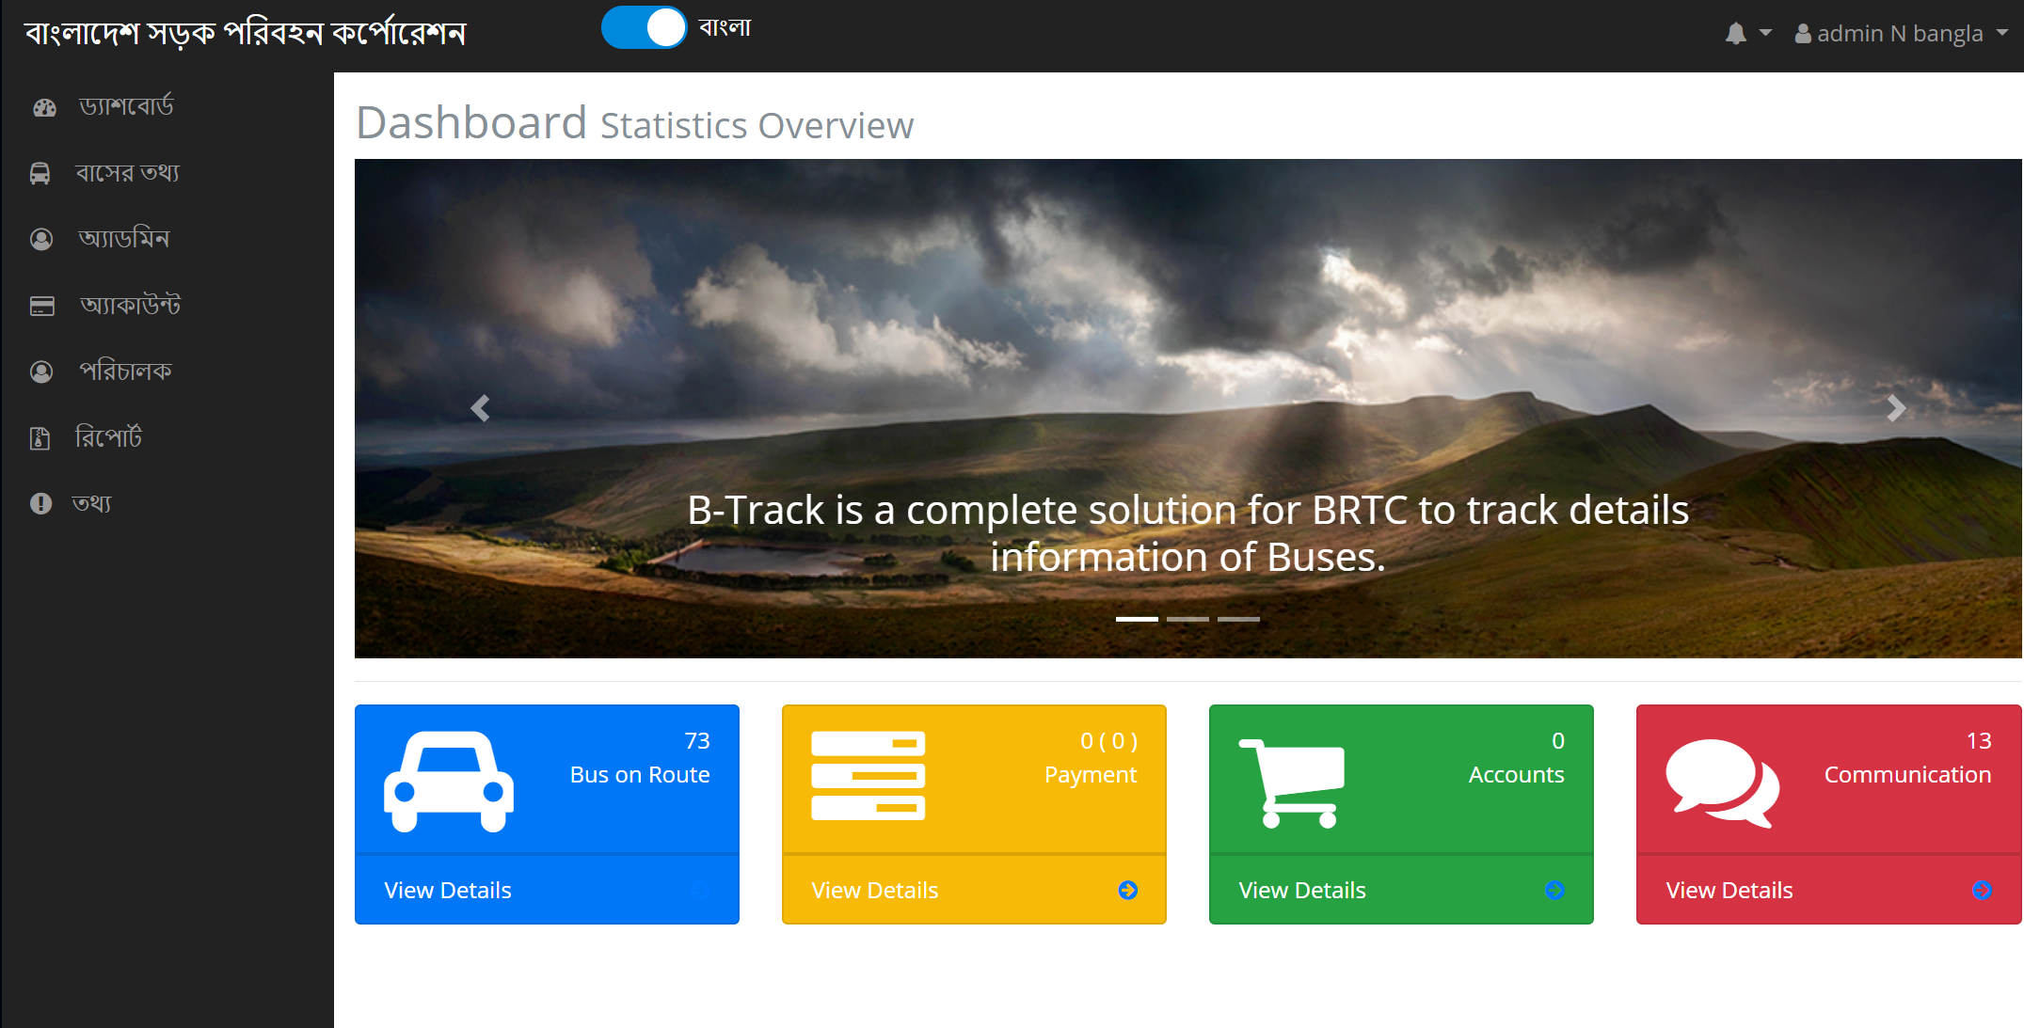
It’s Time To Demonstration

Slide 8


Slide 9
We are with you
Integrated modules are coming soon...
Store Management
Accounting(completed income part)
Proposal:
Bank Deposit Cycle
Driver License number verification.

Slide 10
Thanks
Have a good day

